Slide 1

Module Four: Social Engineering – Hacking Humans
CYB 303 – Prof. C. R. Johnson

Slide 2
How groups are influenced
Concepts like peer pressure, conformity, and self-censorship are likely familiar.
Common propaganda techniques like gatekeeping, stereotyping, unquestioned belief, etc.
Groupthink – Illusion of unanimity, illusion of power
Manipulative language – Emotional appeals, testimonials, circular logic

Slide 3


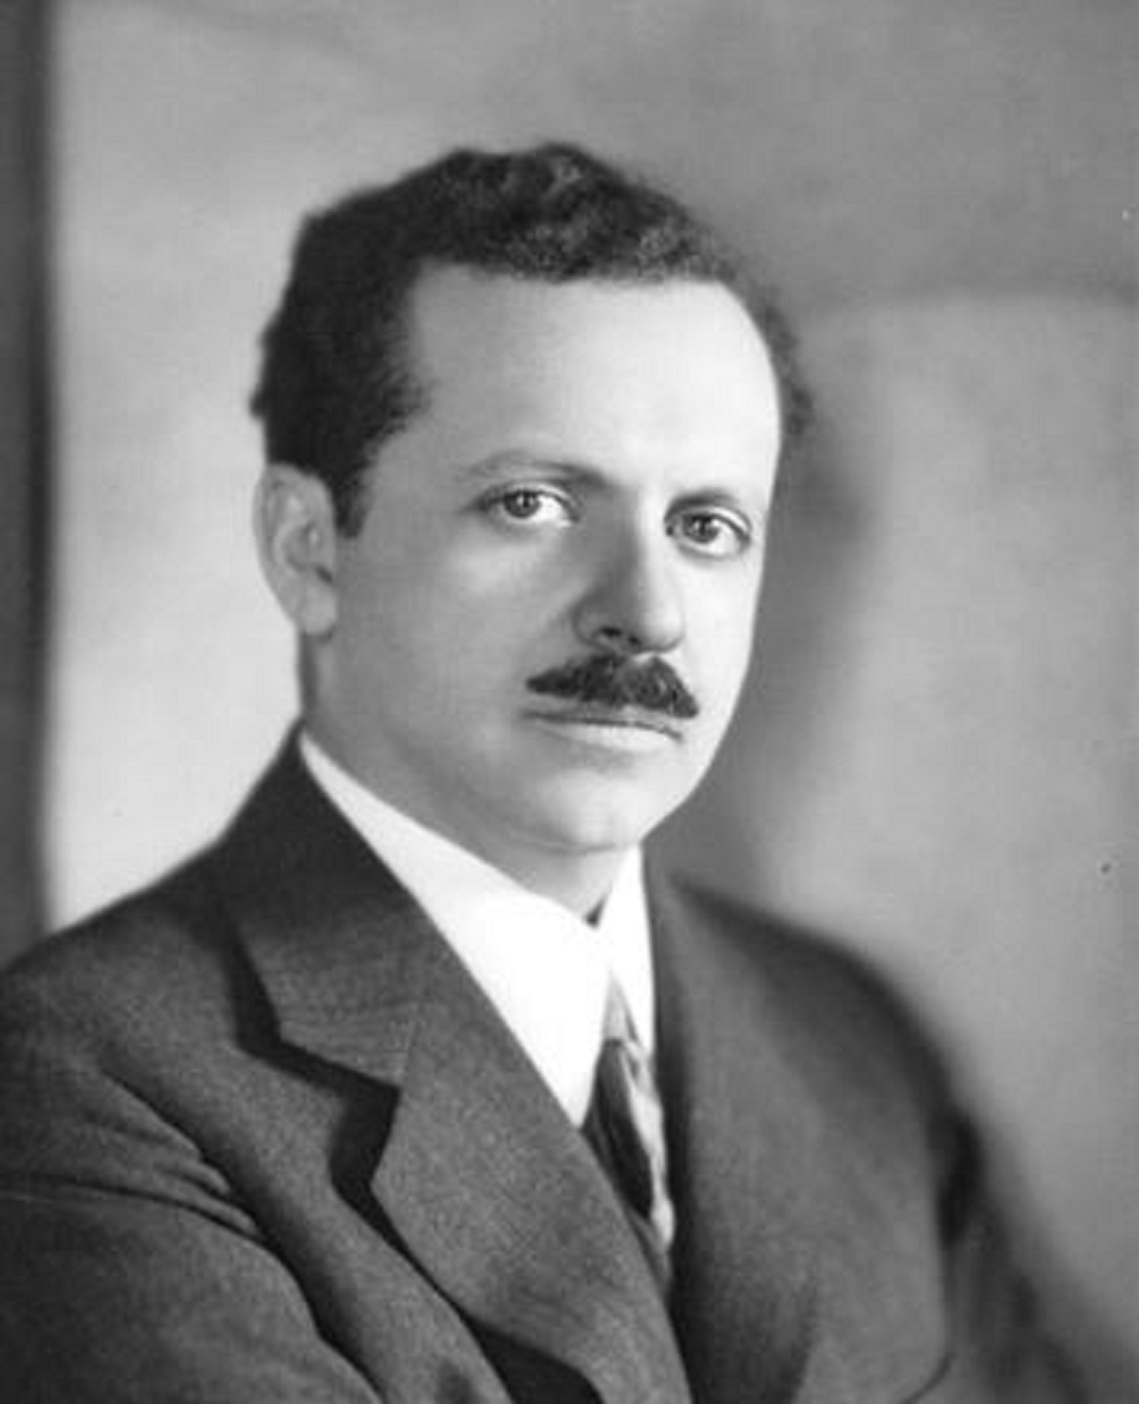
The Puppetmaster
A human being is individualistic, unpredictable, but controllable with overwhelming influence or coercion.
A human being is a system that contains information. Like any system it can be brute-forced, cracked, compromised.
Human beings as a group are shockingly predictable and malleable, but mercurial.
Society is a system that can be manipulated.

Slide 4




Slide 5
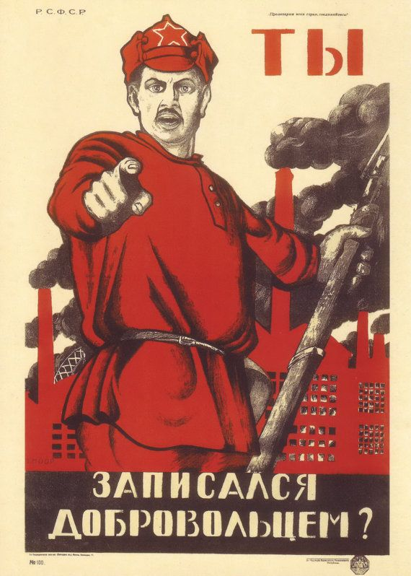


Slide 6




Slide 7

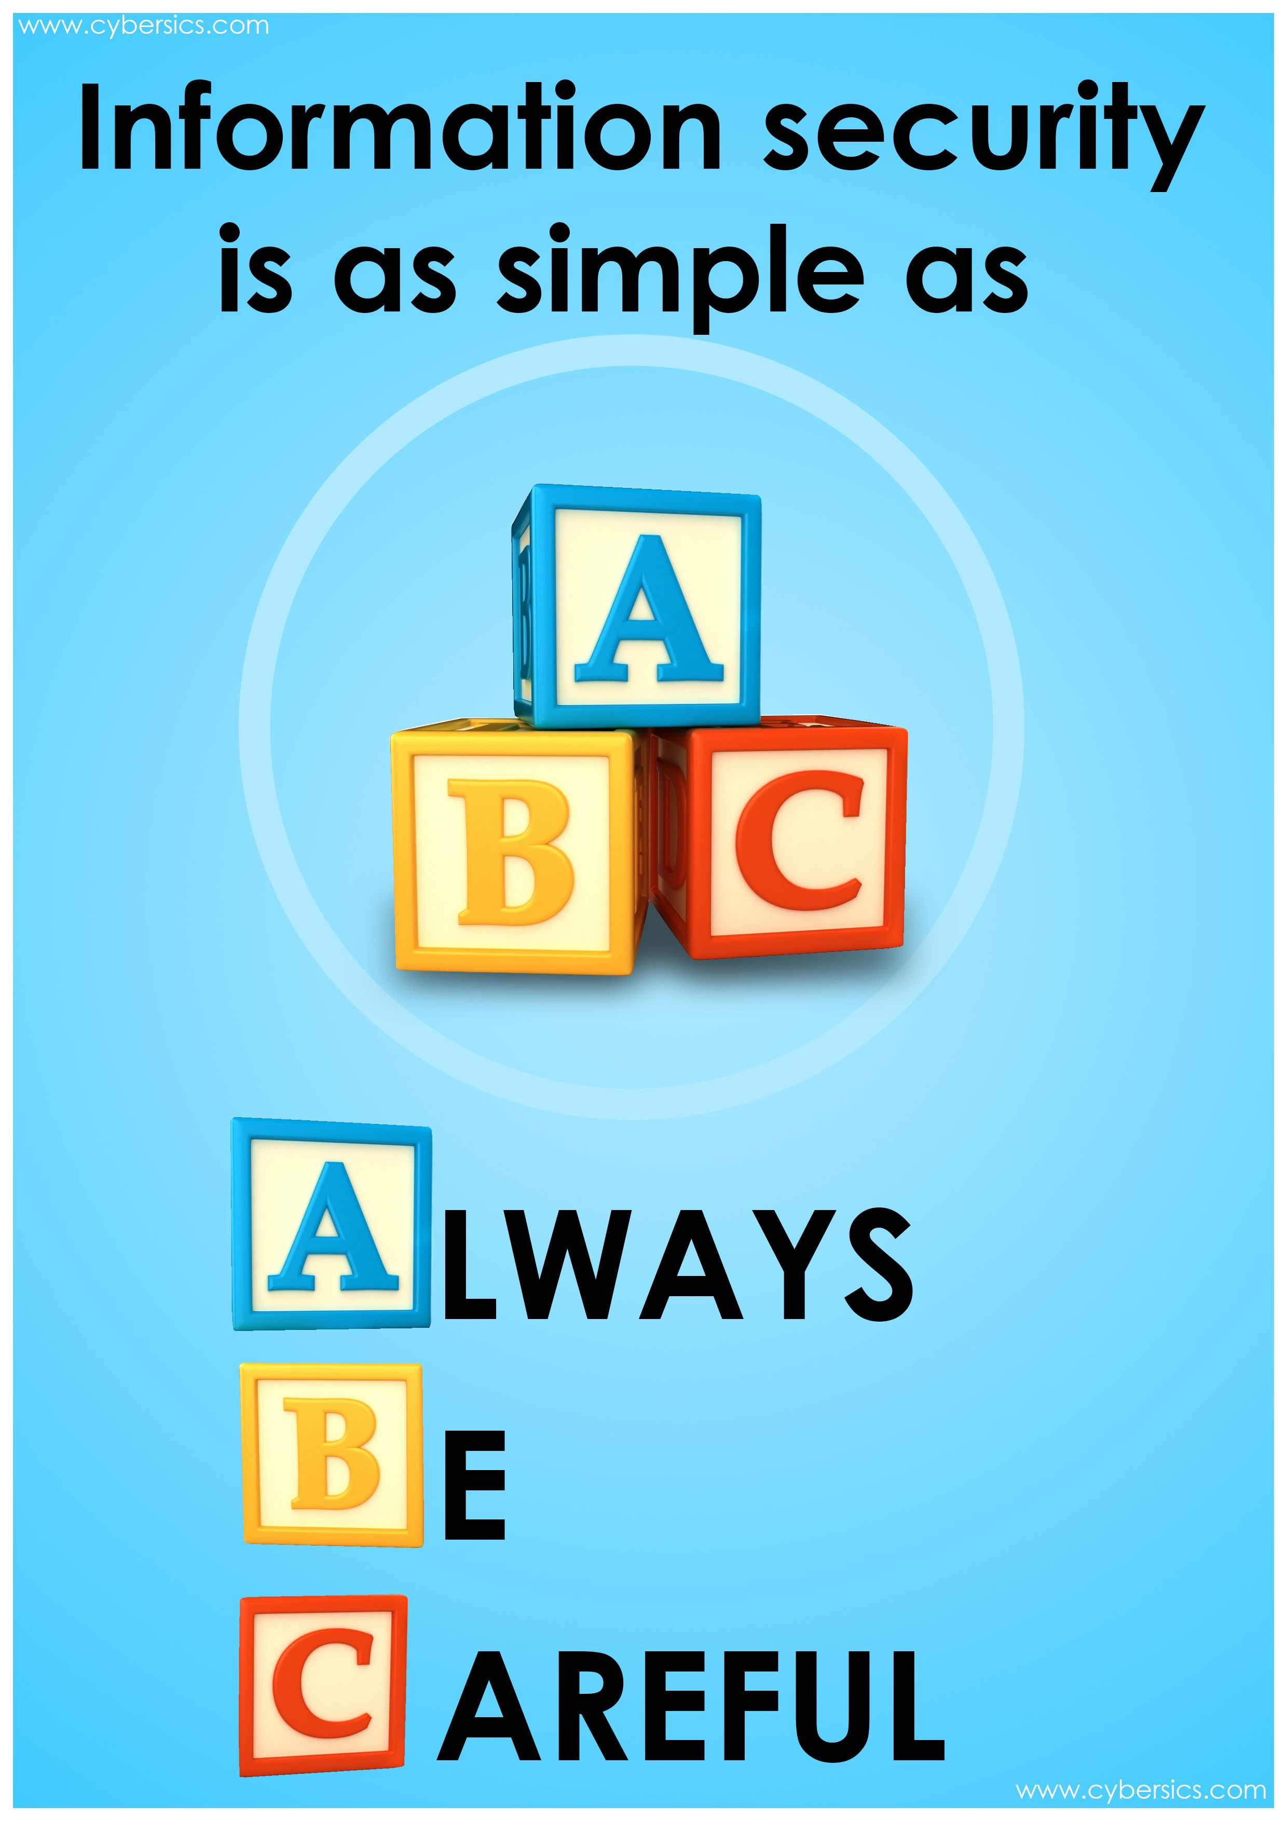


Slide 8

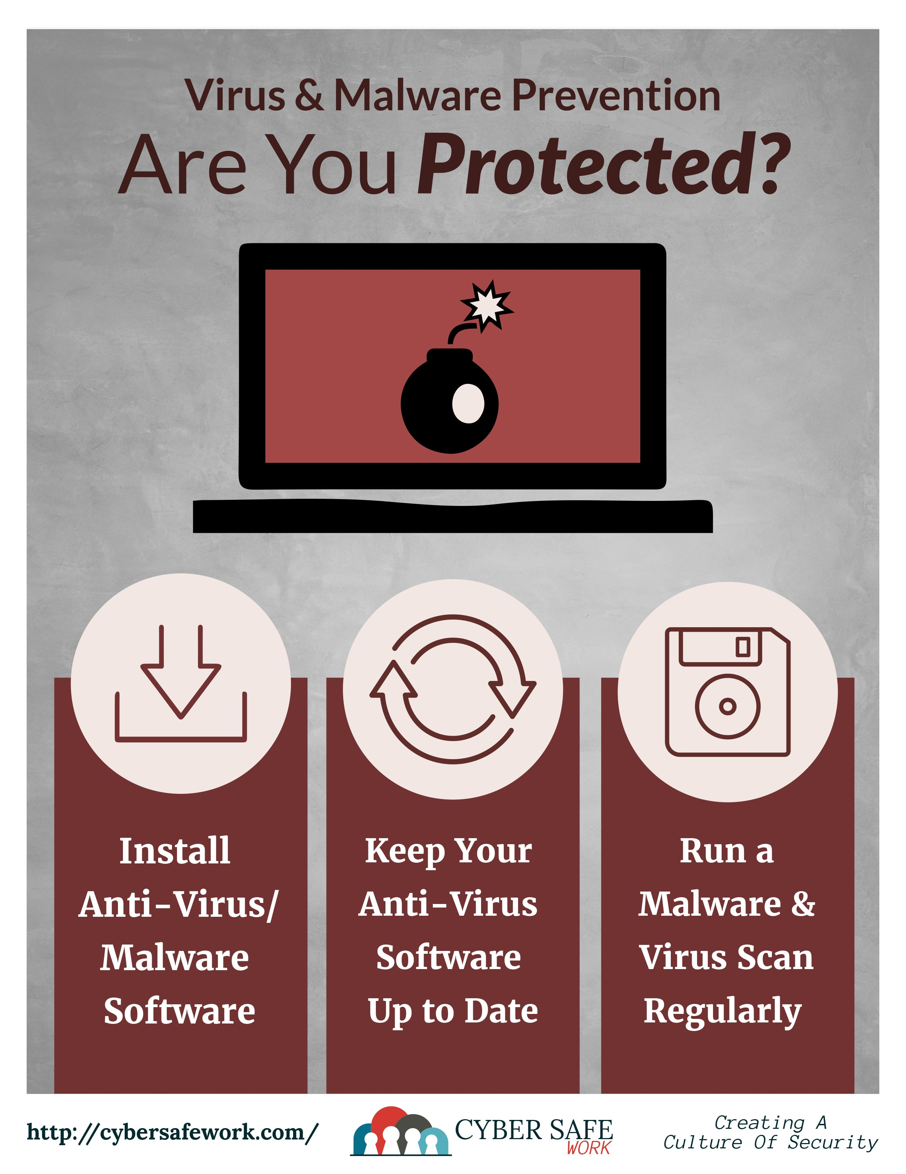
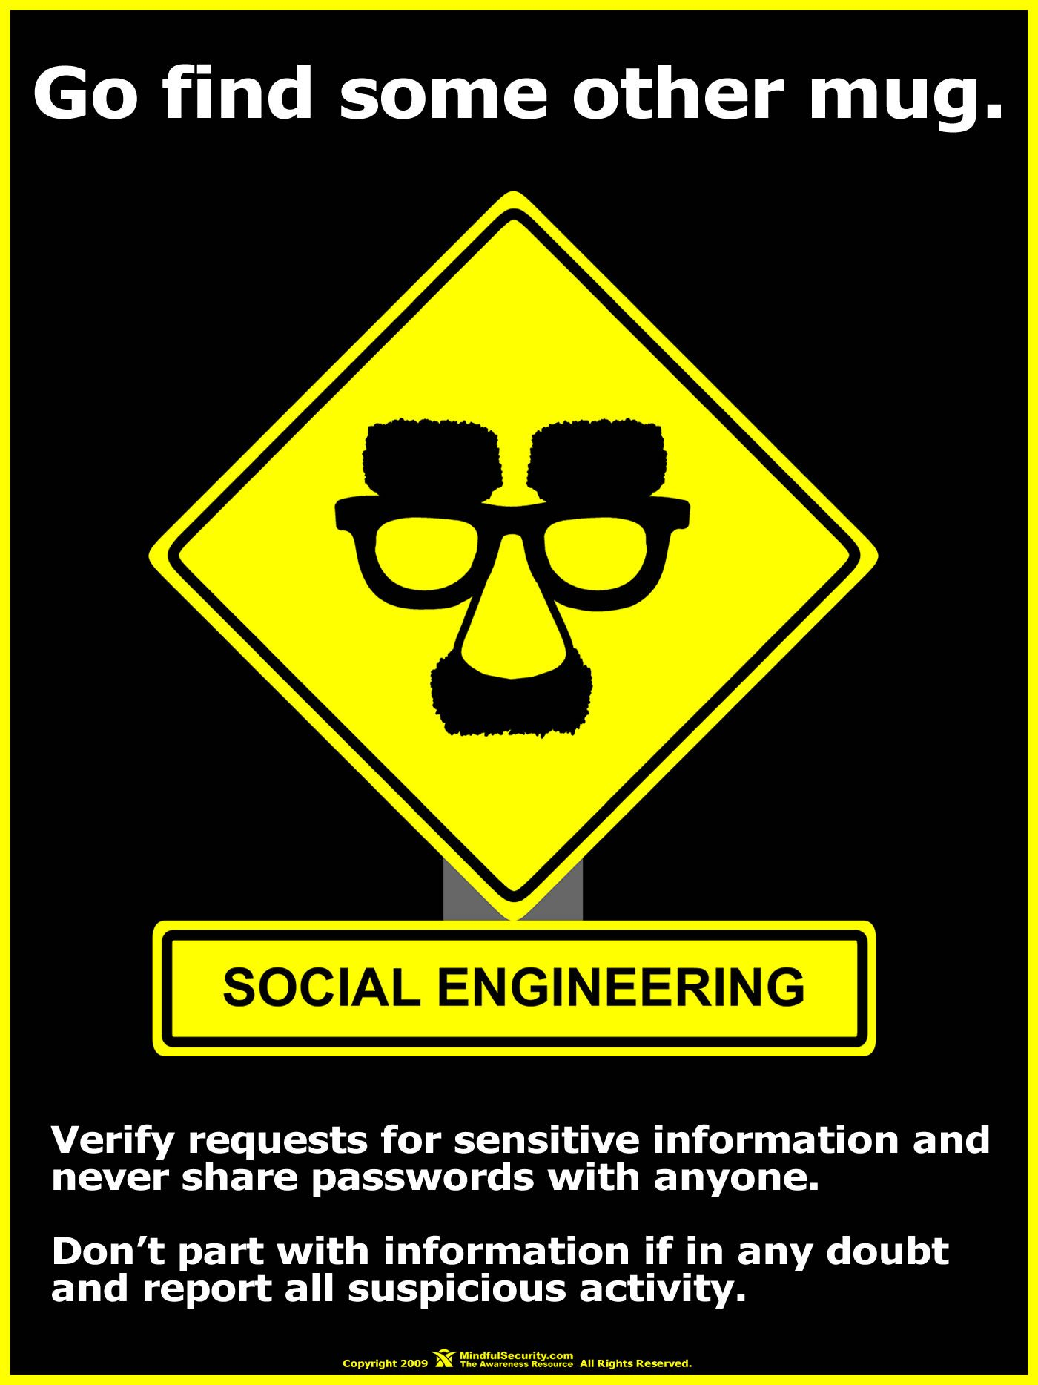

Slide 9

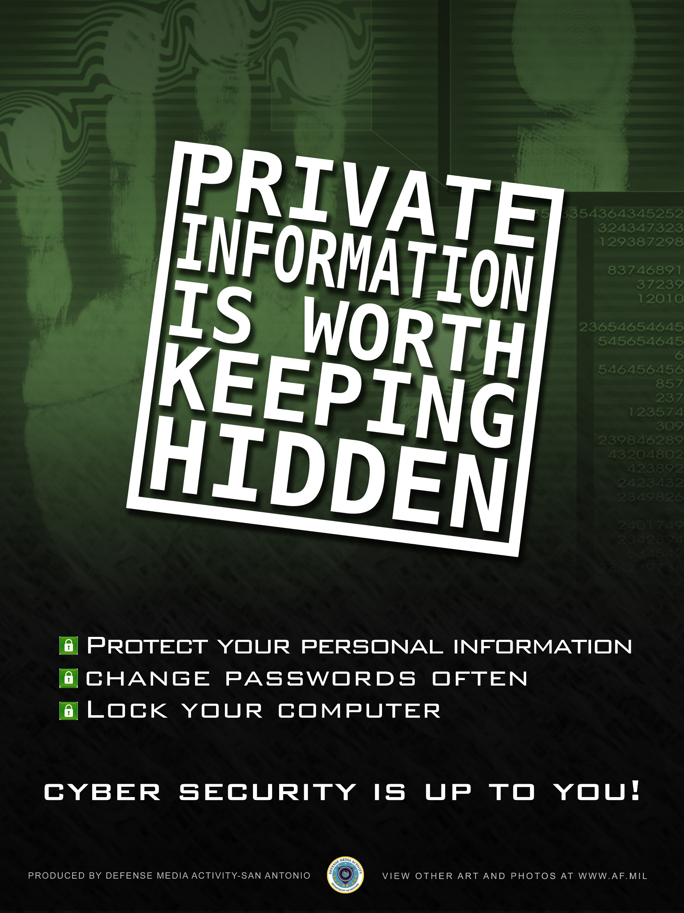

Slide 10
When it fails
Abilene Paradox –
Decision and products of a group may reflect social compromises as opposed to logic. Individuals see this products and regard them as low quality or irrational but have little influence or motivation to change them.
Policy undermines messaging.
You going for a more secure environment – or a compliance checkmark?

Slide 11
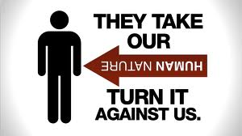
Social Engineering
“You could spend a fortune purchasing technology and services…and your network infrastructure could still remain vulnerable to old-fashion manipulation.”
-Kevin Mitnick

Slide 12
Social Engineering
In a social engineering attack, an attacker uses human interaction (social skills) to obtain or compromise information about an organization or its computer systems.
An attacker may seem unassuming and respectable, possibly claiming to be a new employee, repair person, or researcher and even offering credentials to support that identity.
However, by asking questions, he or she may be able to piece together enough information to infiltrate an organization's network.
If an attacker is not able to gather enough information from one source, he or she may contact another source within the same organization and rely on the information from the first source to add to his or her credibility.

Slide 13
Summary
Social Engineering is insidiously tricky to combat, but not impossible.
The human is the weakest link in any security system, and yet is the trickiest to exploit.
Training is the best defense against attacks.
Ethics plays an important role in defending against social engineering.

Slide 14
Angle of attack
There are two main flavors of social engineering attack with hundreds of variations of each.
Pretexting – A false reason to conceal the truth. For example – Refund scammers.
Pretensing – A false reason concocted to stretch the truth. For example – An alcoholic telling their sponsor that they haven’t had any whiskey today while leaving out the fact they have a handle of vodka in the car.

Slide 15
Social Engineering - Pretexting
Pretexting is a form of social engineering where attackers focus on creating a good pretext, or a fabricated scenario, that they can use to try and steal their victims’ personal information.
More advanced attacks will also try to manipulate their targets into performing an action that enables them to exploit the structural weaknesses of an organization or company.
Notes:
A good example of this would be an attacker who impersonates an external IT services auditor and manipulates a company’s physical security staff into letting them into the building.

Slide 16
Social Engineering - Pretexting
Pretexting requires interaction with a target. A little interaction or a lot. With enough effort, well executed it is also very likely to succeed when building a false sense of trust with the victim.
This requires the attacker to build a credible story that leaves little room for doubt on the part of their target.
Debt Collection Fraud Call
Honeypot/Catfishing Scams
Notes:
Most pretext attacks do not put forth that much effort.
Pretexting attacks are commonly used to gain both sensitive and non-sensitive information.

Slide 17
Social Engineering
Phishing – Send out bait to fool victims into giving away their information
Fake Websites – Molded to look like the real thing. Login with real credentials that are now compromised
Fake Pop-up – Pops up in front of real website to obtain user credentials
Deepfakes – Fake audio and video that makes a person appear to be saying something the did not say

Slide 18
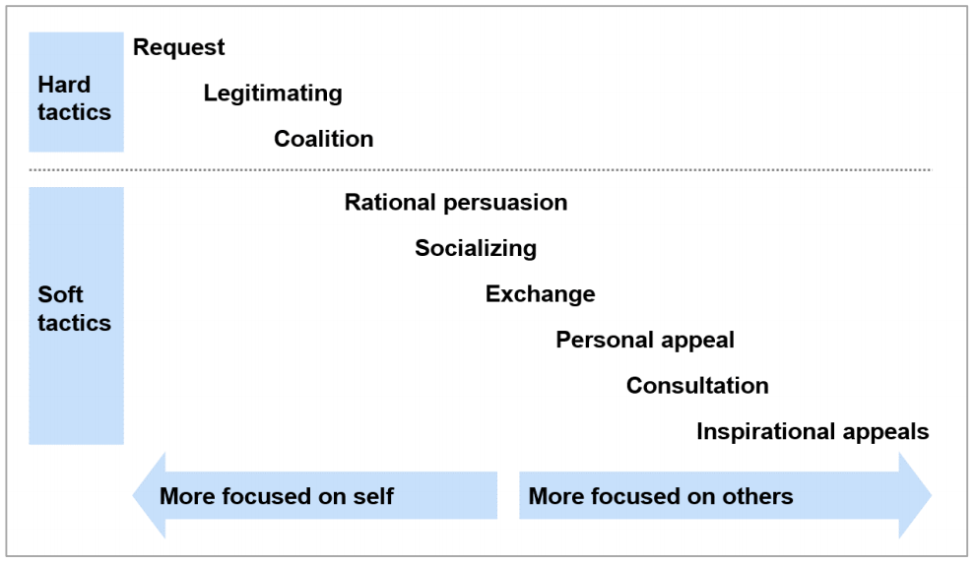
Ways Individuals are influenced

Slide 19
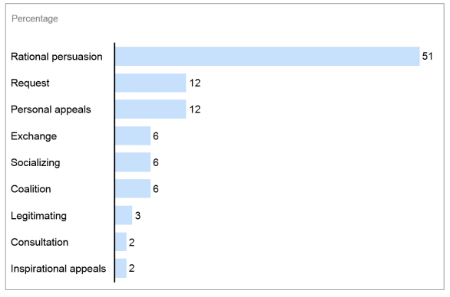
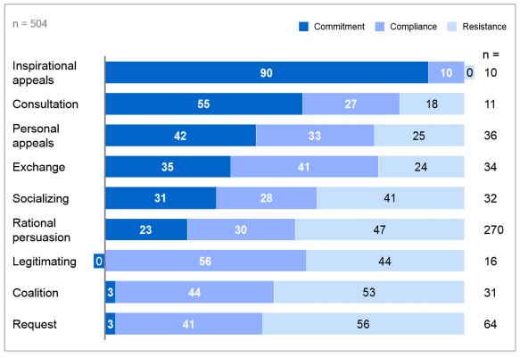
Most used – Most effective

Slide 20
Security Assessments
Initial Scoping
What the client is trying to find out
Parameters of the engagement
Reconnaissance
Targets
“Get out of jail free” letter
Assessment
Actual physical/computer attacks
Reporting / Presentation

Slide 21
Security Holes
Where are the weak points in a system?
Area of Risk | Tactic
Phone (Help Desk) | Impersonation and persuasion
Building entrance | Unauthorized physical access
Office | Shoulder surfing/looking for open offices
Mail room | Insertion of forged memos
Machine room/Phone closet | Gain access/remove equipment/attach analyzer to get confidential data
Phone & PBX | Stealing phone toll access
Dumpsters | Dumpster diving
Intra-Internet | Key Loggers/password capturing software
Office Desks | Stealing sensitive documents

Slide 22
Attack Strategies: Operations
Research! Do your homework!
Network scan? Know the boss’ computer.
Get a foot in the door. Assistance?
Are the computer’s unlocked? How’s the security?
What information is needed? Where is it?

Slide 23
Why is it effective?
People want to help.
People fear authority.
People feel its ok to give small, innocuous pieces of information.
People don’t give a second thought to unusual instances, and so many security breaches go unreported.

Slide 24
What’s involved
Site observation
Physical / Wireless observation
Phishing
Email
Phone phishing
Social Engineering
Access to perimeter/building
Access to network
Access to systems

Slide 25
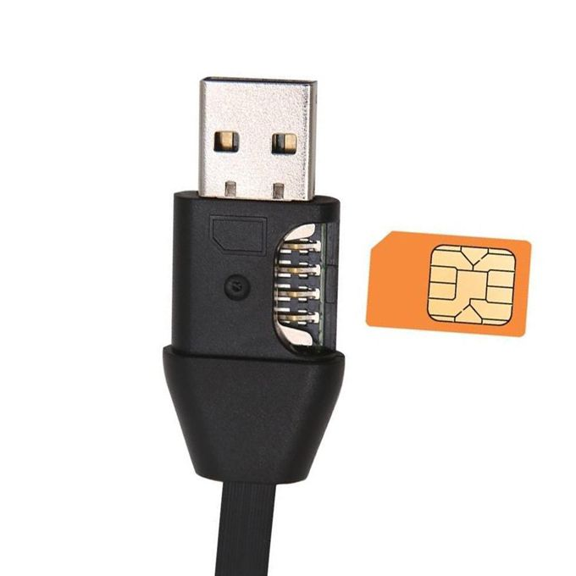
Social Engineering Tool Kit
USB drops
Spy cables
Scanning tools
Covert entry kit
Proxmark
Camera
Attire
Badge
Fake work orders
Fake business cards
Rogue AP

Slide 26
Countermeasures
What can be done to prevent some of these attacks? Training
Passwords
Document handling
Shredding confidential data
Lockup of confidential data
Physical security
Badge control
Guest escort
Phone tracking/monitoring

Slide 27
Ethics
How does ethics apply?
Spells out procedures.
Clearly defines who to call.
Encourages questioning of unusual instances.
Introduces tight controls to limit the ability of someone giving out confidential information.

Slide 28
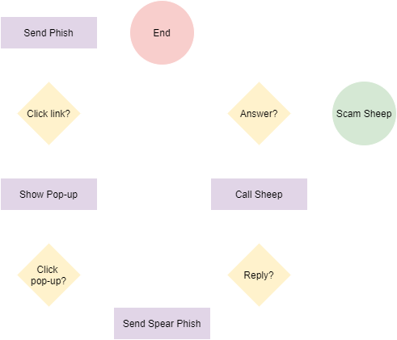
Social Engineering +
Social engineering can be very effective in an era of social media. A little research on a target unearths copious amounts of information that could be used to pretext/pretense or intimidate a victim.
There are ~2.4 billion active Facebook users. It’s estimated that around 1/3rd of those are fake accounts.
Combining individual social engineering tactics with large-scale data collection can make scamming much more effective.

Slide 29
Another route
Social media also provides a route around organization protections.
Not only are technical controls more lax, but behavioral schema tend to be less professional and off-guard.

Slide 30
Types of Phishing
Phishing attempts directed at specific individuals or companies have been termed spear phishing. Attackers may gather personal information about their target to increase their probability of success.
Clone phishing is whereby a legitimate, and previously delivered, email containing an attachment or link has had its content and recipient address(es) taken and used to create an almost identical or cloned email.
Phishing which is directed specifically at senior executives and other high-profile targets within businesses may be referred to as whaling.

Slide 31
Phishing
An easy way to lure a large pool of unsuspecting people
Was considered a victimless crime – now part of most criminal activity
Has developed over time and morphed to meet the changing environment
1864 Spam message
1978 DARPA network spam/phishing email
1987 True phishing email with payload
1995 AOL - associated with the warez community that exchanged pirated software and the hacking scene
Criminal Elements – buy email addresses, accounts and information

Slide 32
Why Phishing Still Works
Lack of computer system knowledge.
Lack of knowledge of security and security indicators
Visually deceptive text
Images masking underlying text
Lack of attention to security indicators.
Lack of attention to the absence of security indicators.

Slide 33
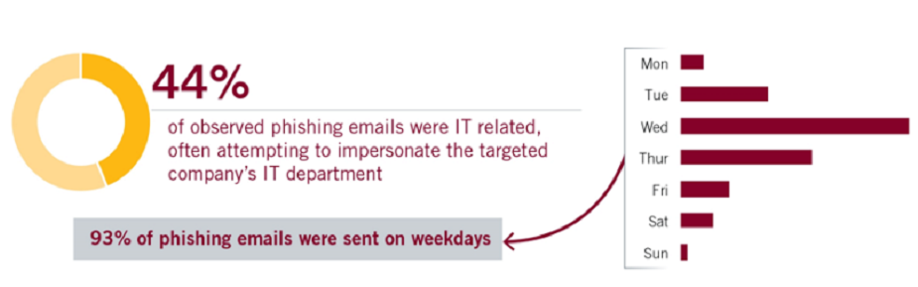
Timing of Phishing Events

Slide 34
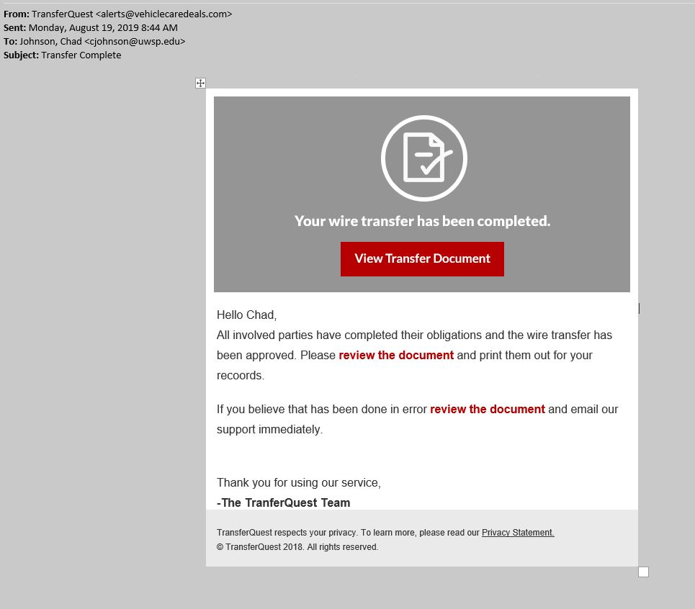

Slide 35
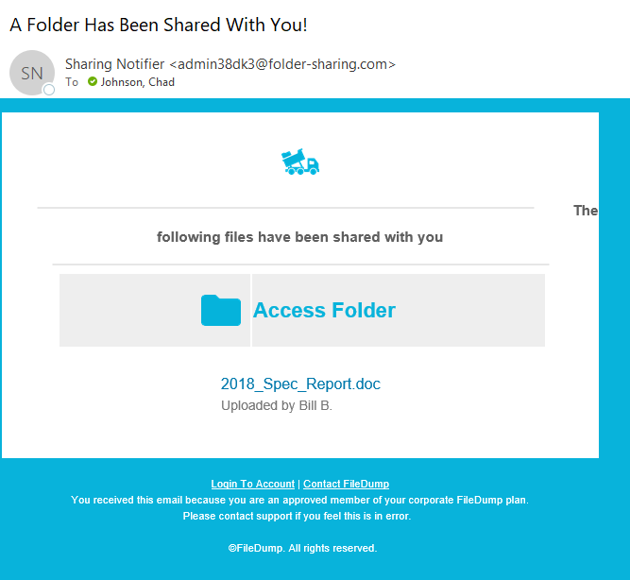

Slide 36
Defenses
Protect your computer with spam filters, antivirus/anti-spyware software, and a firewall, and keep them updated.
Create a company email or hotline to report security incidents.
Make an effort to standardized URLs / redirect
Training that focuses on…
Recognizing URLs / email addresses
Reporting suspicious behavior
The value of information they have

Slide 37
Defenses
Additional physical security awareness ensure that only those persons authorized to be in the facility has been granted access.
Easy secure document destruction
Lock dumpsters
Erase magnetic media
Escorted visitors
A strong badging process
Train employees to challenge strangers
Reinforce the importance of physical security

Slide 38
Reinforcement mechanisms
As part of this training or education process, reinforce a ‘good catch’ made by an employee.
When an employee does the right thing, make sure they receive proper recognition. Train the employees on who to call if they suspect they are being socially engineered.

Slide 39
A Culture of Awareness
Annual security awareness training
Monthly security tips
Internal phishing
The “See it Say it” Program

